Slide 1
Detecting Fraudulent Signatures
Tommy Gallagher

Slide 2
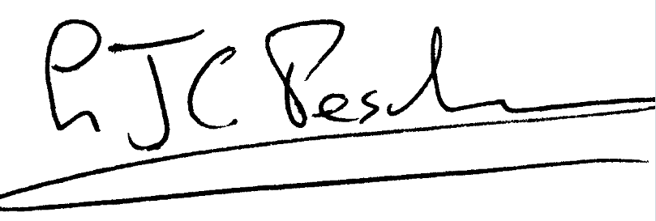
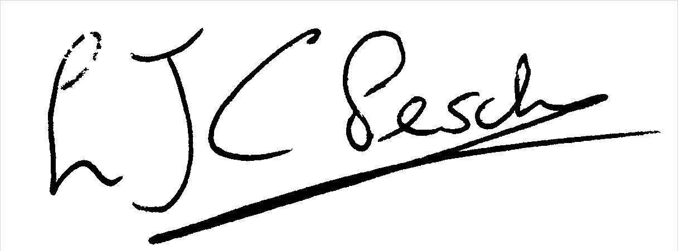
Objective:
Given a real signature:
Is this signature genuine or forged?

Slide 3
Process:
Created a Siamese Neural Network to take in two images at a time
Pass each image through a Convolutional Neural Network simultaneously
Calculate Euclidean Distance to see similarity between two images
Make prediction based on Euclidean Distance

Slide 4
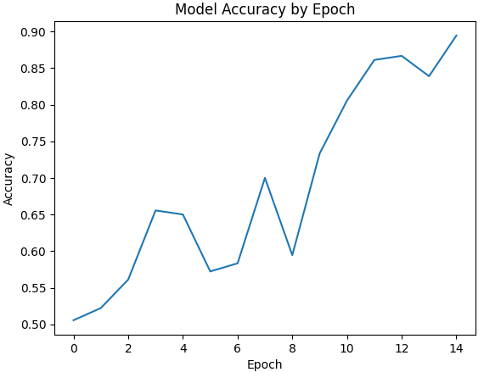
Results:
Network trained over 15 epochs with 89.44% accuracy on Training set
60% accuracy on Validation set
46.67% accuracy on Testing set

Slide 5
Takeaways:
Model didn’t perform as well as desired on testing set, may be due to overfitting
Determining the correct margin to use to separate predictions of real and forged signatures was very important to success when training model (ended up using 0.4)
Different optimizers could produce different results
Processing images prior to sending them into the network was a time consuming task, real data is not always simple to use

